Slide 1
Update on the Drivers of rents project
Nam Ngo - HUD
HTWG May 2022

Slide 2
Outline
Literature review
Data availability
Some data visualization
Next steps

Slide 3
Literature review
Research on drivers of rents is quite limited, both internationally and in NZ
US/Australia/NZ
The majority of research has focused on drivers of house prices and rents usually enter the equation as given or as a fixed annual increase
However, it’s possible to use model specification in house prices studies for rent prices
Notes:
Countries: AUS/NZ/US
There’s also some other studies in European countries too, but circumstances are too different, some countries have loose form of rent control. E.g Switzerland, rent is tight to mortgage rate (LLs can’t raise rent if mortgage rates do not increase)
As rental market and housing market, albeit not perfectly substituted, have similar products

Slide 4
Models
VAR
Reduced-form OLS (with appropriate lags)
Spatial equilibrium (US)

Slide 5
Potential drivers
Variable | Sign | Channel | Notes | Countries | Models
Income/Wage | + | Renters’ ability to pay | Useful to explore the different impact of income (across all) vs wage (working people) and personal vs household income | All | OLS/VAR
Relative supply and demand: Population Internal migration Unemployment rate Number of dwellings People per dwelling Vacancy rate | + | Supply/demand gap Desirable household size | Two main approaches: Include supply and demand variables separately 2-stage: Estimate the supply and demand gap (vacancy rate or people per dwelling) separately | All | OLS/VAR
Notes:
Household income is more related to the ability to pay rents (and household formation is endogenous to housing situation)
Unemployment rate & job security impact desirable household size (smaller) and demand

Slide 6
Variable | Sign | Channel | Notes | Countries | Model
Lagged rent inflation | + | High momentum | Rents are highly persistent | All | VAR/OLS
Interest rates | + | Homeownership rate Cost of owning | Some claim that it explains part of the “price puzzle” from monetary policy shocks | U | VAR
House prices | + | User cost NPV of rents | With lags | U | VAR/OLS
General inflation | + | Landlords’ expenses | Inflation less rents | U | VAR/OLS
Internal migration (population elasticity to rents / cross-cities population elasticity to rents) | + | Location demand | How do we define “local” housing market If all elastic, it does not matter where supply is | U/N | VAR/OLS/Spatial equilibrium
Interactions of two or more of the above |  |  | Almost everything interacts with supply and demand
Notes:
1. Lagged rents, e.g in Australia, coefficients of lagged rents inflation summed to 0.7
2. Rent is a big part of CPI)
5. Location demand: Demand to live in some specific (supply-inelastic) cities. E.g Move from Auckland to provinces in the North, overall rent increases as rent rises more in inelastic cities
If population is perfectly elastic, i.e people can move as they wish => it does not matter where we buy/subsidy
Income and rent is a by product of supply and demand gap

Slide 7
Data availability
Data | Sources | Frequency | Variables | TA/Regional level | Notes
Rental Price Index | Stats | Monthly | RPI stock and flow | Yes | Some TAs are too small (too few repeated transactions) to construct timeseries of index
Tenancy bond data | MBIE | Monthly | Active bonds, New bonds, Median/Geometric mean rents, | Yes
Number of dwellings | Stats (Census + consents) | Quarterly/Monthly | Number of dwellings | Yes
 | Electricity Authority | Monthly |  | National only
 | HUD | Monthly |  | Yes
Income/wage | Stats/HUD | Monthly | Average household income, average weekly earnings | Yes | Some modelling may involved in creating regional/TA series
House prices | Corelogic/REINZ/HUD | Monthly | House price index | Yes
Notes:
Vacancy rate: listings (Trade Me)/bonds (MBIE)
Vacant time: Using tenancy turnover to calculate the time that a property is vacant

Slide 8
Data | Sources | Frequency | Variables | TA/Regional level | Notes
Internal migration | Stats NZ (admin data) | Yearly | Inward and outward migration between regions/TAs | Yes | Constructed from IDI, not published Monthly/quarterly is possible but with lower quality
Other macro indicators | Stats NZ | Quarterly | CPI CPI less rents Unemployment rate | No
Short-term listings | InsideAirBnB | Quarterly/Monthly | Web-scraped data on Airbnbs; number, location, property type, bedroom size, availability, host size, price. | Yes | Other sources of short-term rental are missing (e.g bookaback, etc)
Trade Me listings (for vacancy measure) | TM | Monthly | Number of listings, views/ enquiries | Yes? | Sensitive to TM's market share Regional/TA coverage is inconsistent
Building consents | Stats | Monthly | Building consents issued | Yes

Slide 9
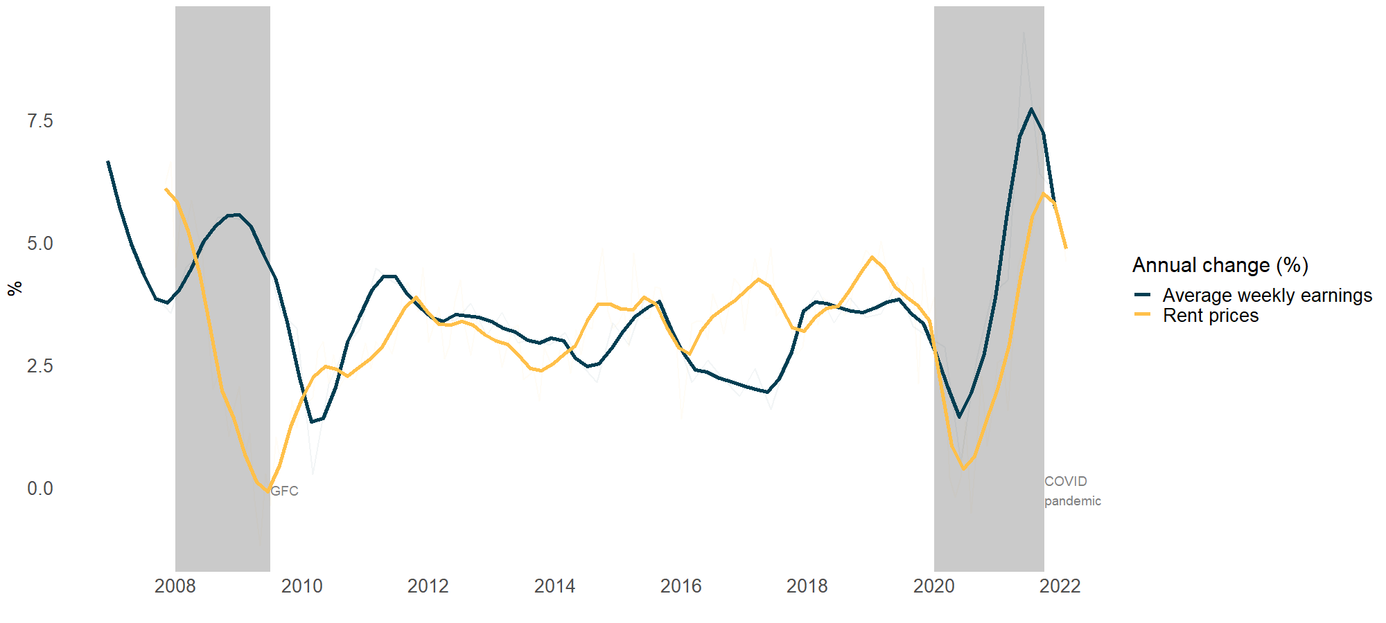
Income vs rent
Notes:
Not always positively correlated => need to include an interaction variable with other factor (supply demand?)

Slide 10
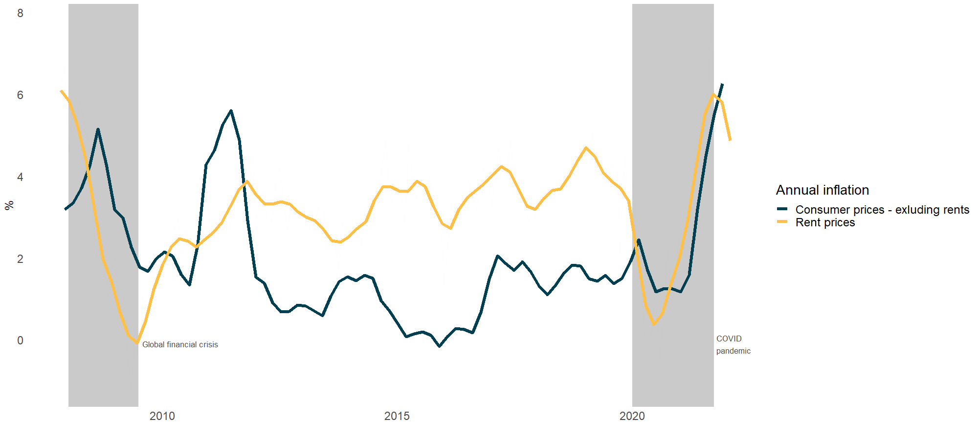
CPI less rents vs rents

Slide 11
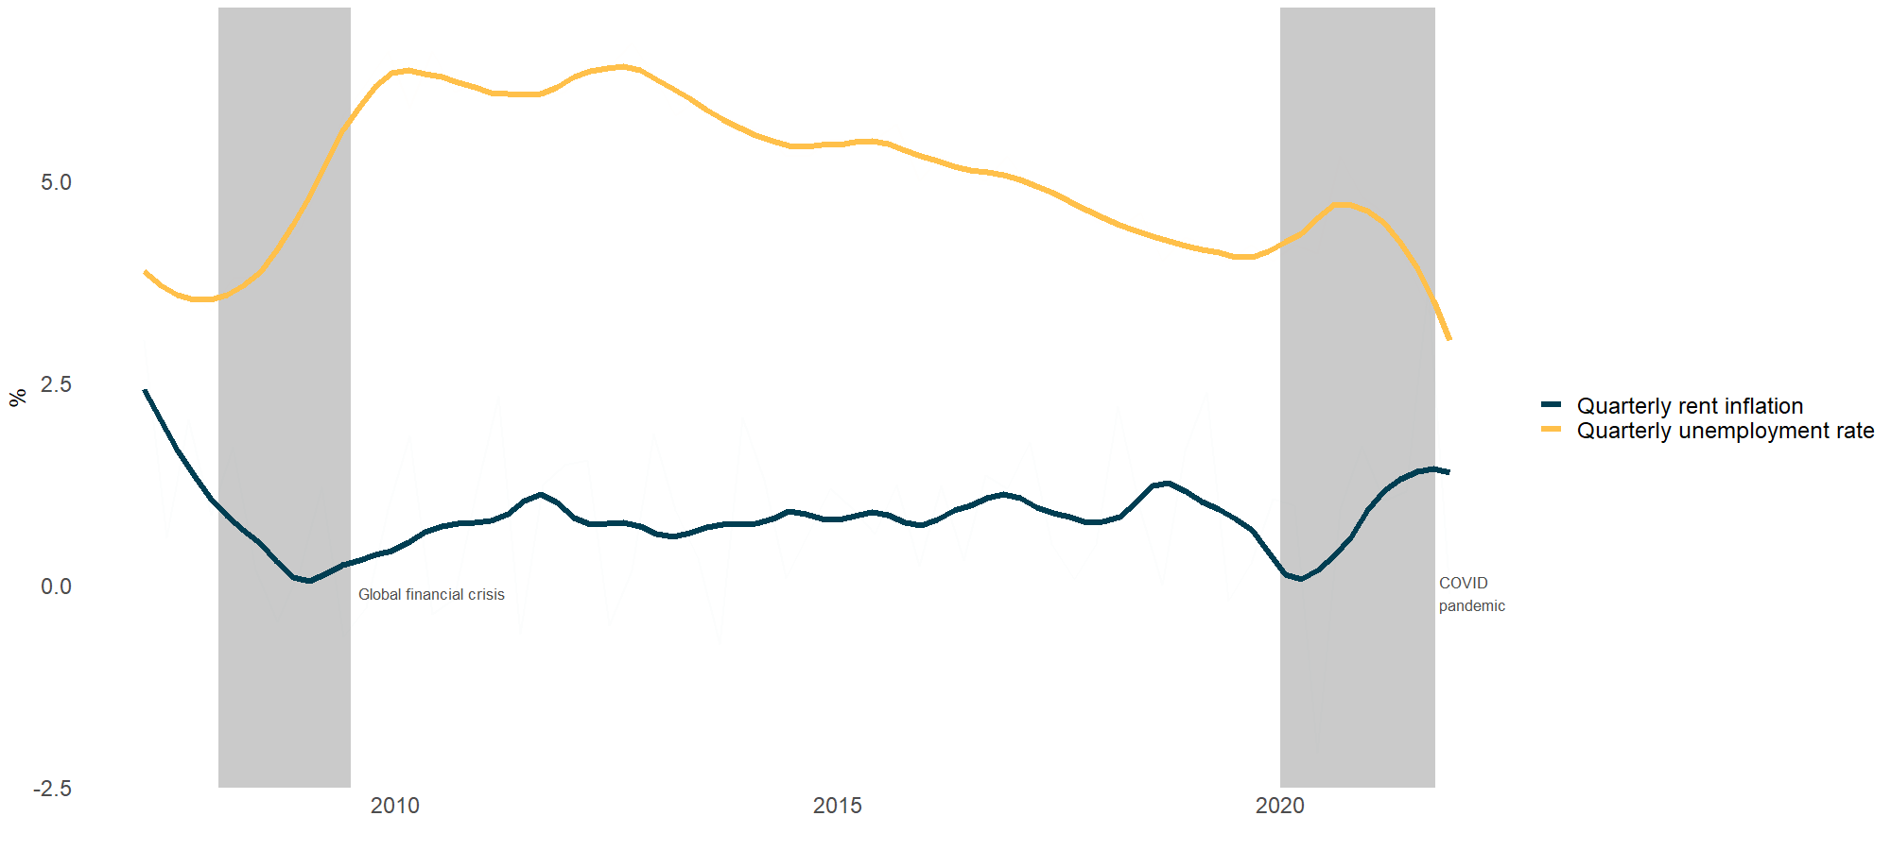
Unemployment vs rents

Slide 12
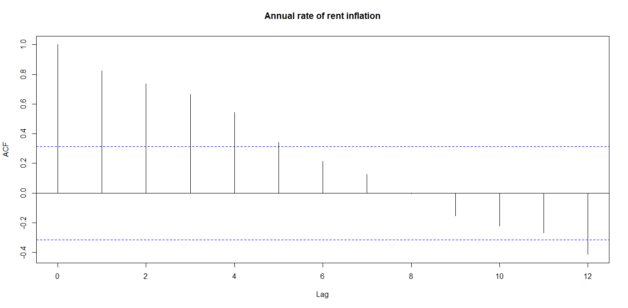
Lagged rents vs rents
Notes:
Monthly RPI flow, annual rate: High autocorrelation, 4 lags

Slide 13
People per dwelling vs rents
Notes:
Refer to Alan’s work

Slide 14
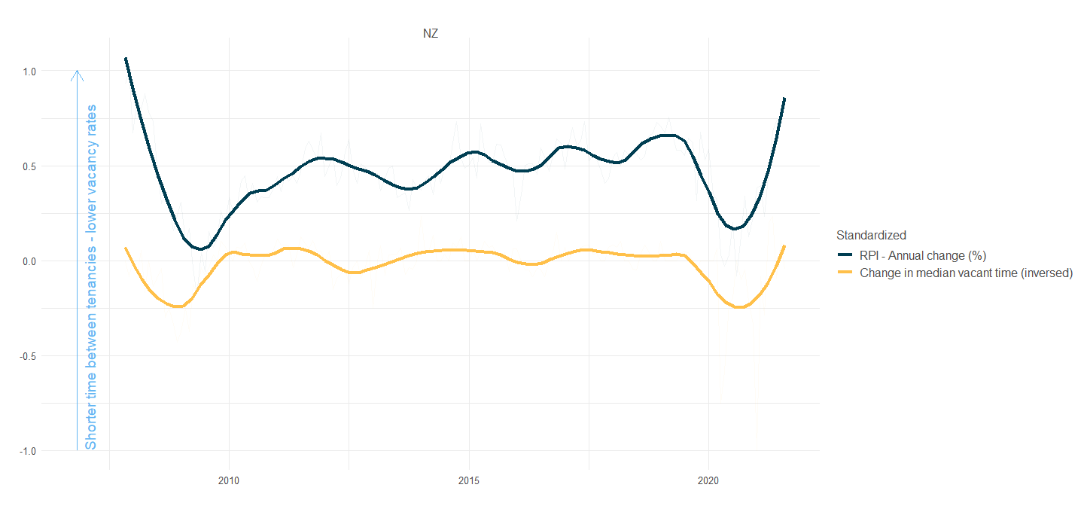
Vacancy rate vs rents
Notes:
High correlation at national level, not as significant at regional level

Slide 15
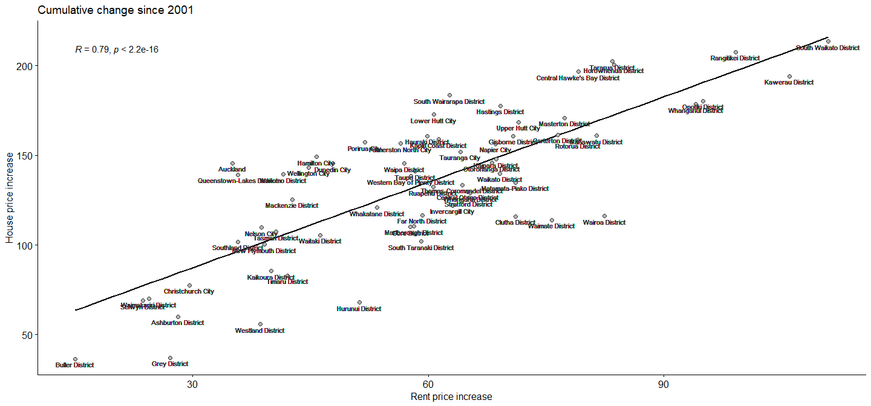
House prices vs rents

Slide 16
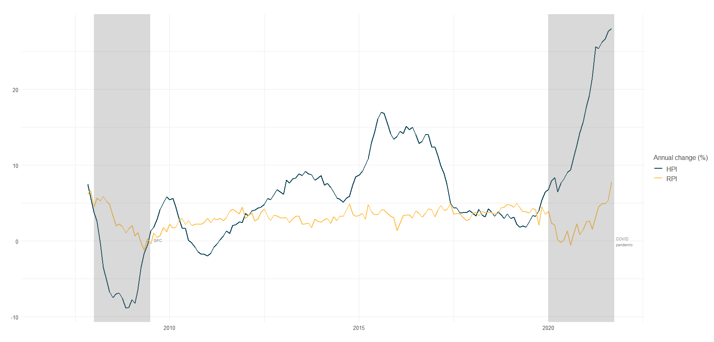
House prices vs rents
Notes:
Moving together but the swings in house prices are much bigger
Correlation vs causation: Confounding variables that impact both or reverse causality

Slide 17
Next steps
Reduced-form OLS/VAR at national level with potential drivers (and appropriate lags)
Panel regression at region/TA level
Suggestions?

